Slide 1


Spotify Analysis
By Prince Goyal

Slide 2
AGENDA
2
Project Walkthrough
Tools Used
Overview of the Dashboard
Key metrics and insights
Learnings
Acknowledgement
Notes:
Photo by Frank Septillion on Unsplash

Slide 3
Project Walkthrough
Requirement Gathering/ Business Requirements
Data Walkthrough
Data Connection
Data Cleaning/ Quality Check
Data Modelling
Dax Calculations
Dashboard Layout
Chart Development and Formatting
Dashboard development
Insights Generations
Notes:
Photo by Frank Septillion on Unsplash

Slide 4
Tools Used
Power Query Tool (Data Cleaning)
Charts, KPIs, Slicers
Hyperlink option (LinkedIn)
Data Relation or modelling
DAX Calculation
Format Painter
Drill Through Feature
Custom Formatting for color coding
Matrix
Format Option - Alignments
Notes:
Photo by Frank Septillion on Unsplash

Slide 5
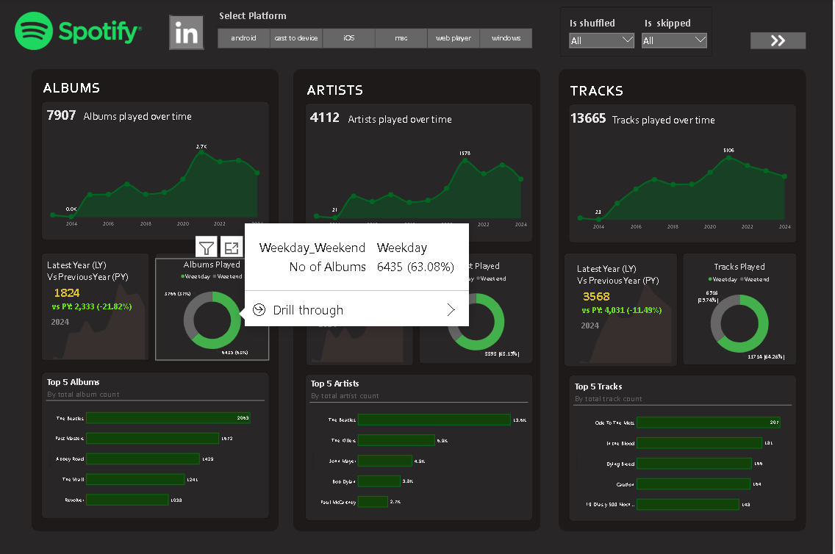
Overview Snippet
5
Notes:
Photo by Frank Septillion on Unsplash

Slide 6
Key Metrics and Insights
Albums
Artists
Tracks
Total Albums Played – 7907
Maximum Albums Played in Year – 2021
Minimum Albums Played in Year – 2014
growth Trend over time
YoY analysis - decline in year 2024(-21.84%)
More engagement on weekdays
Top Album – The beatles, Past masters etc..
Total Artists Played – 4112
Maximum Artists Played in Year – 2021
Minimum Artists Played in Year – 2014
growth Trend over time
YoY analysis - decline in year 2024(-26.39%)
More engagement on weekdays
Top Artists – The beatles, The Killers etc..
Total Tracks Played – 13665
Maximum Tracks Played in Year – 2021
Minimum Tracks Played in Year – 2014
growth Trend over time
YoY analysis - decline in year 2024(-11.49%)
More engagement on weekdays
Top Tracks – Ode to the mets , In the blood etc..
Notes:
Photo by Frank Septillion on Unsplash

Slide 7
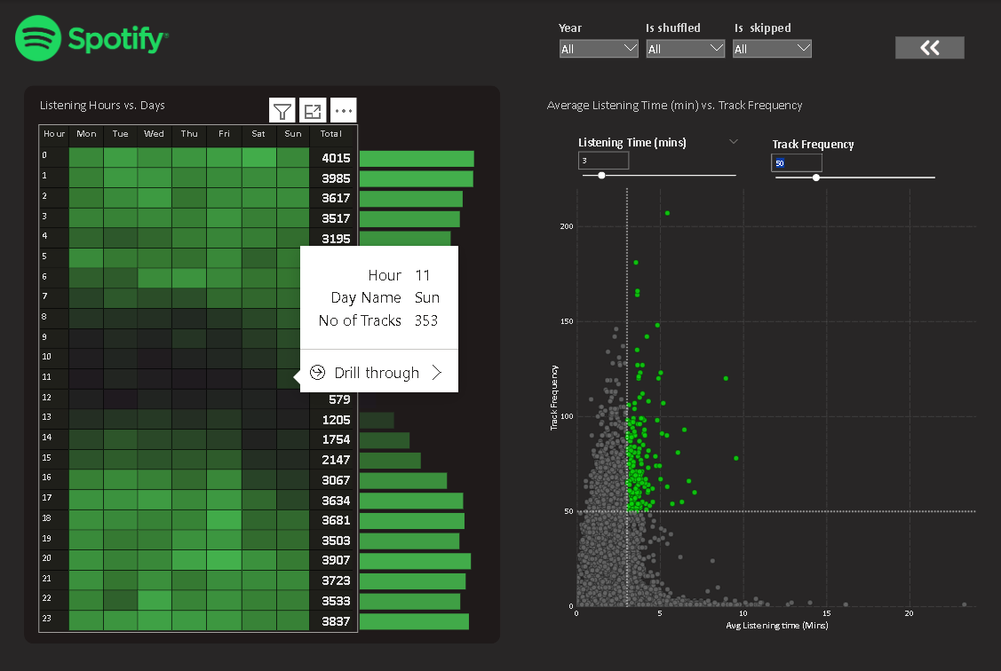
Listening Pattern Snippet
7
Notes:
Photo by Frank Septillion on Unsplash

Slide 8
Key Metrics and Insights
Hourly Trend
Quadrant Analysis
Peak Hours – 8PM to 12 AM
Ideal Hours for promoting releases
Slump Hours – 6AM to 12PM
Due to working hours slightly low
Trend from Light green to Black means High to low
Action Takeaway – to boost usage focus niche and friendly playlist
High Frequency and High Listening Time – More Engaging Tracks
Low Frequency and High Listening Time – Niche but Impactful tracks
High Frequency and Low Listening Time – Short and frequently Played Tracks
Low frequency and Low Listening Time – Less popular tracks
Promoters from here can track there songs and advertise accordingly
Notes:
Photo by Frank Septillion on Unsplash

Slide 9
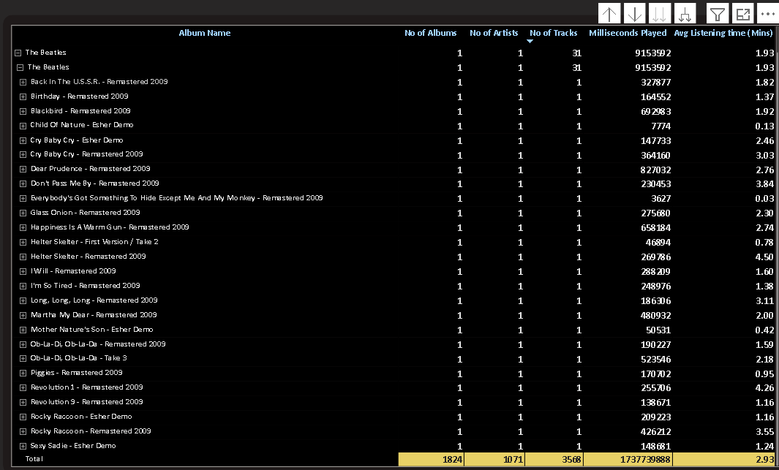
Grid Data Snippet
9
Notes:
Photo by Frank Septillion on Unsplash

Slide 10
Key Metrics and Insights
Grid Analysis
Drill-Down Hierarchy – Data structured as Album -> Artist -> Tracks -> Playtime for detailed analysis.
Total Summary – 1,824 albums, 10,171 artists, 3,568 tracks with a total playtime of (483 hours).
Drill Up and Drill Down Feature for the hierarchical view of data
Hierarchical View Mode
Drill Through Feature Enable for the key insights
Structured Approach helps in analyzing trends at different levels
Filters help on focusing specific frames and categories
Notes:
Photo by Frank Septillion on Unsplash

Slide 11
Learnings
11
Transforming datasets into actionable insights by identifying KPIs and visualizing them on an interactive dashboard to drive data-driven decisions.
Analyzed how streaming platforms do promotions and advertisment
Power Bi tools - Table, charts and slicers, DAX calculations including Column and Measures, Power Query for data cleaning, Drill through, Data Modelling and relationship between them, Hyperlinks etc..
Dashboard Layout - Design dashboards that balance functionality and visual appeal through expert use of layout principles, color harmony, and data visualization techniques tailored to user needs.
Data storytelling - Learn how to effectively communicate insights through data storytelling
Learn how to limit the number of visualizations per dashboard and strip away unnecessary ink like gridlines, borders, and axis labels
Notes:
Photo by Frank Septillion on Unsplash

Slide 12
Aknowledgement
12
I would like to express my sincere gratitude to my esteemed teacher, Mr. Diwakar Sir, at DUCAT IT Training School for his valuable guidance and support. His mentorship has provided me with the essential skills and knowledge required to confidently present this project, titled “Spotify Analysis Dashboard."
This project has significantly enhanced my proficiency in Power BI and deepened my understanding of data analysis. I am truly grateful for the opportunity to learn under his expert guidance, which has played a crucial role in strengthening my analytical and technical skills.
Notes:
Photo by Frank Septillion on Unsplash

Slide 13
Thank You

